Slide 1
www.judaica-europeana.eu Judaica Europeana: single access to Jewish heritage digital collections December 2011 Tres hermanicas, a Judeo-Spanish Romance, Sarah Gorby, with José Luis on the guitar Arion ARN 34226, 1974

Slide 2
Europeana ― the vision
Europe’s digital libraries, archives and museums online
A showcase for Europe’s cultural and scientific heritage
A flagship project of the European Commission and the European Parliament.
“A digital library that is a single, direct and multilingual access point to the European cultural heritage.”
European Parliament, 27 September 2007

Slide 3
The Europeana Universe
Judaica Europeana
MIMO
BHL
Museum A Archive A Library A
HOPE
Library X
Carrare
Culture.fr
CulturaItalia
BAM
CIMEC etc……
Europeana
Connect
National Digital Library
EURO-Photo
STERNA
Archive X
ECLAP
Film Archive X
Film Archive 1
Film Archive 2
Film Archive 3
Museum X
EFG
EuropeanaLocal
ACE
Natural Europe
EDL
APEnet
ICOM Europe
IMPACT
Europeana Regia
Museum 1
CENL
ATHENA
Museum 2
The European Library
MICHAEL
NL 1 NL 2 NL 3
IASA
Eurbica National Archive 1
Europeana
Travel
VideoActive
FIAT
National Archive 2
Sound Archive 1
Sound Archive n
National Archive 3
Trebleclef
Television Archive 1
Television Archive n
PrestoPrime
EUScreen

Slide 4
The Judaica Europeana project
brings digitized Jewish heritage collections online to
a single multilingual access point: Europeana.eu
documents Jewish history and heritage in Europe
with a focus on urban life

Slide 5
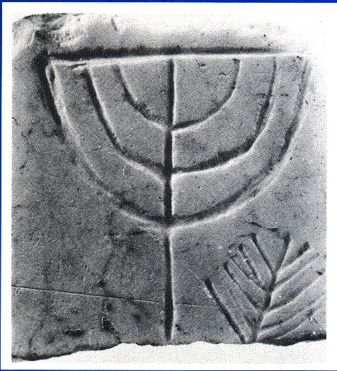
Jewish presence in Europe
Jews are the longest-established minority in Europe with Jewish inscriptions in Greece dating back to the 3rd Century BCE.
Marble plaque, bearing the images of a menorah, lulav and etrog. Found near the ancient synagogue in the Agora of Athens. Probably part of the synagogue’s frieze, 3rd – 4th C.E. Jewish Museum of Greece

Slide 6
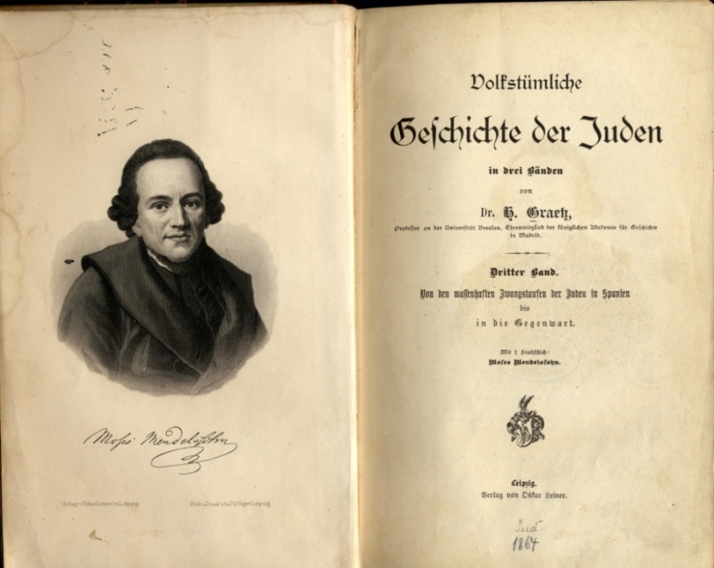
Jewish contribution to European cities
Jewish cultural expressions in Europe can be documented through objects dispersed in many collections: documents, books, manuscripts, periodicals, photographs, works of art, religious artefacts, postcards, posters, audio-recordings and videos, as well as buildings and cemeteries.
History of the Jews by Heinrich Graetz, Leipzig 1864. Copper engraving of Moses Mendelssohn by A. and TH. Weger. Judaica Collection, Goethe University Library

Slide 7
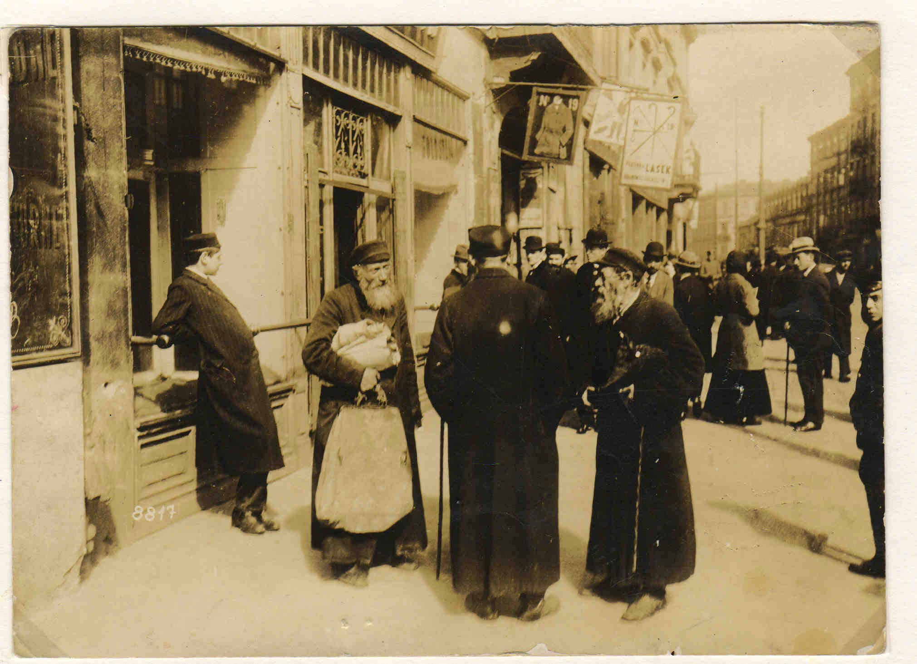
Jewish contribution to European cities
London’s East End and the Belleville quarter of Paris were once thriving Jewish areas with Jewish shops, cafés, schools, libraries, publishing houses, newspapers and theatres.
In the harbour of Thessaloniki, before World War I, economic activity stopped on the Day of Atonement.
One-third of Warsaw’s population was Jewish in the 1930s.
Warsaw, Nalewki Street (1915-1918)
From the collection of the Jewish Historical Institute, Warsaw

Slide 8
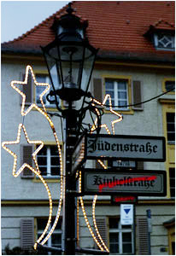
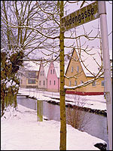
Jewish contribution to European cities
Urbanisation and occupational specialisation has led to the identification of Jews with specific streets, neighbourhoods and other urban phenomena.
The J-Street Project by Susan Heller. Compton Verney Trust and the DAAD, Berlin, 2005. A book, installation and video produced with the support of the European Association for Jewish Culture.

Slide 9
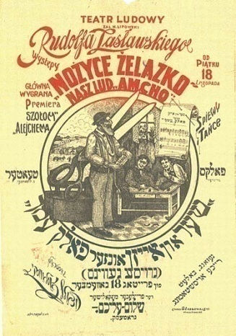
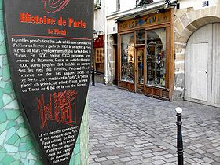
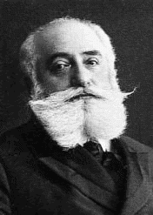
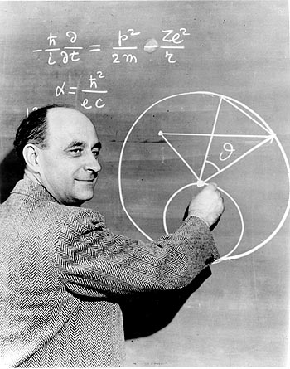
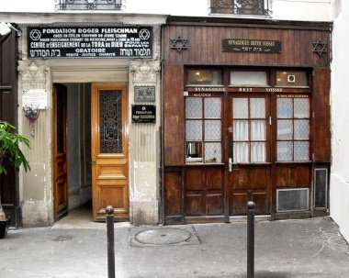
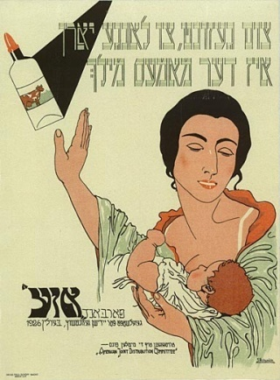
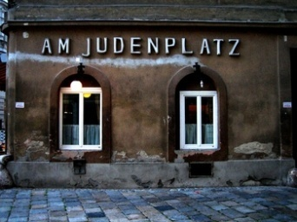
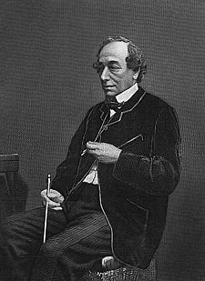
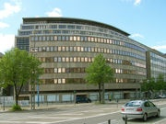
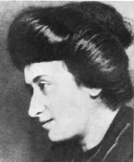
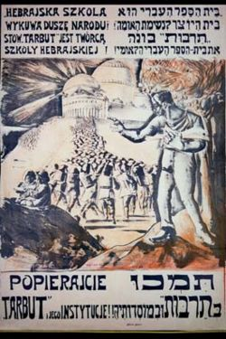
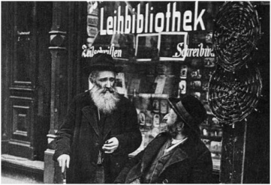
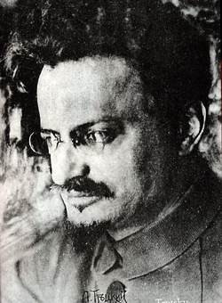
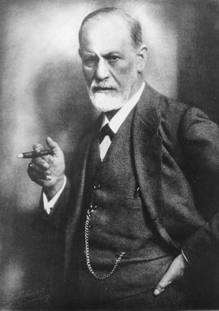
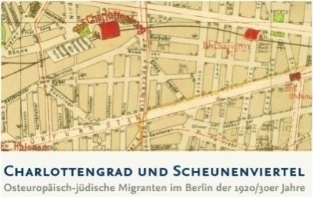
Jewish contribution to European cities

Slide 10
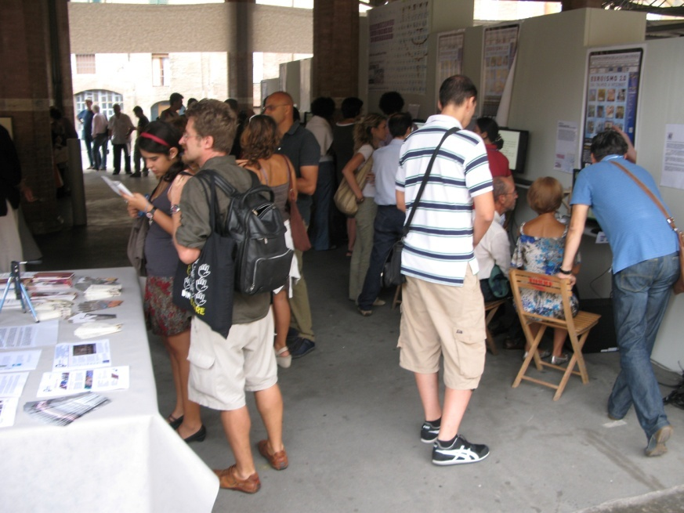
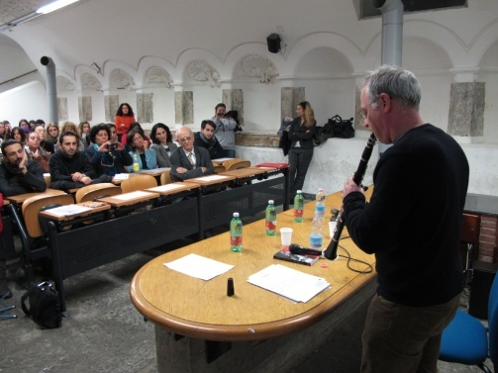
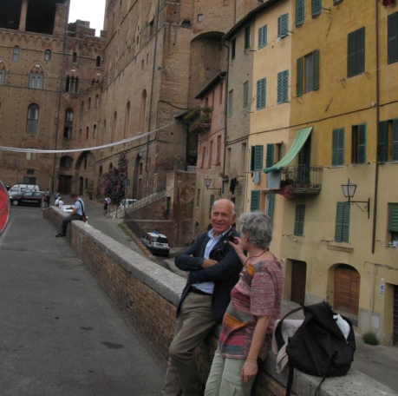
Jewish culture in European cities today
Jewish life was rebuilt after the Holocaust. Today there are vibrant Jewish communities and widespread interest in Jewish culture and creativity.

Slide 11
The project trajectory
First stage 2010-2012
Led by the European Association for Jewish Culture and Frankfurt University Library and launched with 10 partners in 7 countries
Current network includes 26 institutions in Europe, Israel and the US.
Funded by the eContentPlus program of the European Commission, the Rothschild Foundation (Hanadiv) Europe and project partners.
Second stage 2012-14
Continued aggregation of associate partners’ collections
Participation in ‘Digital Manuscripts to Europeana’, a new EC-funded digital project, which will contribute content and technology to Europeana.

Slide 12
The network today
24 institutions: museums, libraries and archives
Partners
European Association of Jewish Culture, London
Judaica Sammlung der Universitätsbibliothek der Goethe Universität, Frankfurt am Main
Alliance Israélite Universelle, Paris
Amitié, Centre for Research and Innovation, Bologna
British Library, London
Hungarian Jewish Archives, Budapest
Jewish Historical Institute, Warsaw
Jewish Museum of Greece, Athens
Jewish Museum London
Ministry of Cultural Heritage and Activity (MiBAC), Rome
National Technical University, Athens
Associate Partners
Ben Uri Gallery – The London Jewish Museum of Art
Bibliotheca Rosenthaliana, Amsterdam
Center for Jewish History, New York
Harvard University Library
Jewish Historical Museum, Amsterdam
Jewish Museum Berlin
Jewish Museum, Frankfurt/Main
Leopold Zunz Centrum, Halle-Wittenberg
Lorand Collection, Augsburg University
National Library of Israel, Jerusalem
Paris Yiddish Center—Medem Library
Sephardi Museum, Toledo
Central Zionist Archives, Jerusalem
Ministerio de Cultura, Madrid
Salomon Ludwig Steinheim Institute, Duisberg Museum, Frankfurt/Main

Slide 13
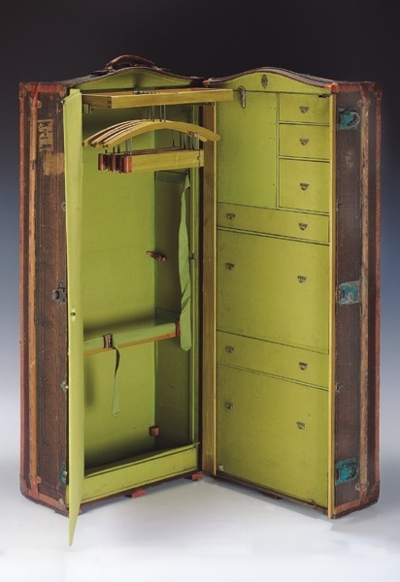
Prospects for extending the network
The following expressed an interest in joining Judaica Europeana:
Aberdeen University Library
Widener Library, Harvard University
Jewish Community Library and Archives, Venice
London Metropolitan Archive
Mantua City Archives
Jewish Museum, Florence
Jewish Museum, Prague
Jewish Museum, Vienna
Jewish Museum, Trieste
Magnes Collection of Jewish Art and Life, University of California, Berkley
Royal Library of Denmark
Travelling trunk brought by a German refugee family to England in May 1939, Mädler Koffer, c.1930, Germany. Jewish Museum London

Slide 14
The benefits for partners and users
Europeana’s multilingual search engine helps users to explore diverse collections. Users can find related information held in other countries, or in other formats, so that Judaica content gains from association with linked material. It makes cross-border and interdisciplinary study possible in new ways.
Europeana exposes partners’ metadata to search engines, making deep web content accessible.
Europeana drives traffic to the collections’ sites by linking users back to the content provider's website.
Users today expect content to be integrated - to be able to see videos, look at images, read texts and listen to sounds in the same space.
Europeana provides a set of APIs through which the data may be re-used and returned in its enriched form by Europeana partners.

Slide 15
Programme of work
Digitisation and aggregation of Jewish heritage content for Europeana.
Coordination of standards across institutions in order to synchronise the metadata with the requirements of Europeana.
Deployment of knowledge management tools : vocabularies, thesauri and ontologies for the indexing and retrieval of the aggregated content.
Dissemination activities to stimulate the use of digitised content in academic research; university-based teaching; schools; museums and virtual exhibitions; conferences; cultural tourism; the arts.

Slide 16
Project achievements – the highlights
Online access to 3.5 million digital objects
Standardization of very diverse metadata
Ingestion of cross-domain content
Laying foundations for integration of content in new semantic web of Linked Data
Deployment of critical elements of LD: vocabularies and collaborative semantic tools
Deployment of knowledge management pilot: the Haskala database

Slide 17
Achievements: dissemination of Judaica Europeana
Website and newsletters
Conferences, seminars, workshops
Virtual exhibitions
44 events in 24 cities:
Amsterdam, Athens, Barcelona, Bergen, Berlin, Brussels, Budapest, Edinburgh, Fermo, Florence, Frankfurt, Halle, Jerusalem, Krakow, London, Madrid, New York, Paris, Poznan, Ravenna, Rome, Southampton, Tel Aviv, Warsaw

Slide 18
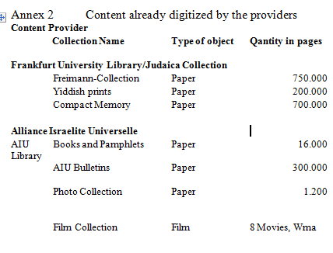
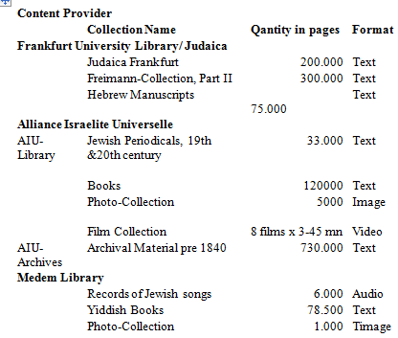
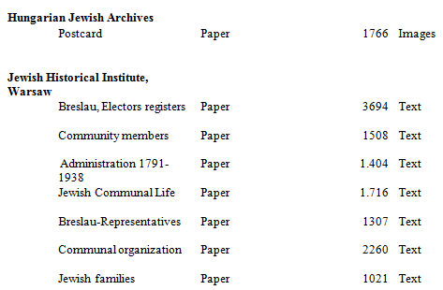
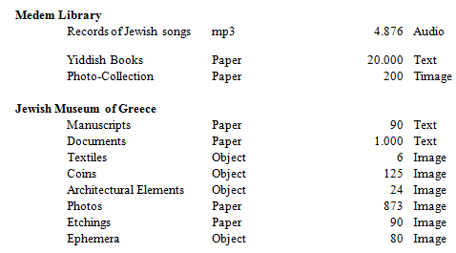
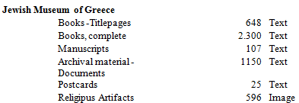
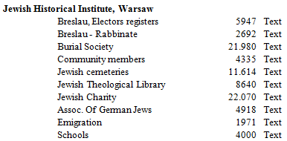
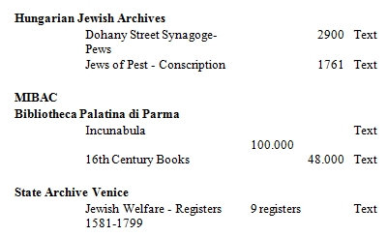
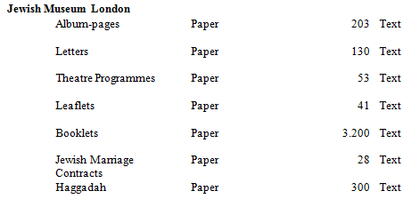
3.5 million
digital objects

Slide 19
Achievements: online access to Jewish heritage
Text 3,459,175
books / incunabula
Videos 2,022
videos
Sound 18,271
music recordings
manuscripts
archives
newspapers / periodicals
oral history
Images 31,580
photographs
postcards
other
3,511,048

Slide 20
The knowledge management pilot project
The Haskala (Jewish Enlightenment) Republic of Letters:
a research project and database, which documents the secularization of Jewish culture in the 18-19th centuries.
Provision of open access to this unique database
Creation of a platform for collaborative research using the semantic mediawiki
Involvement of a group of Haskala scholars

Slide 21
Haskala database functionalities
New functionalities provided by Semantic MediaWiki:
Improved data structure
Searching for information – creating own queries
Automatically generated up-to-date lists
Visual display of information – timelines, graphs, maps
External reuse – data source for other applications

Slide 22
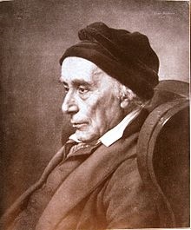
The Haskala database content
Over 1,000 books
detailed data on 521 books
more basic data on 359 books
detailed data on 343 people: authors, editors, translators, booksellers etc
data on 2,430 people in total
data on publishing houses
David Friedländer (1750-1834), writer, banker and communal leader

Slide 23
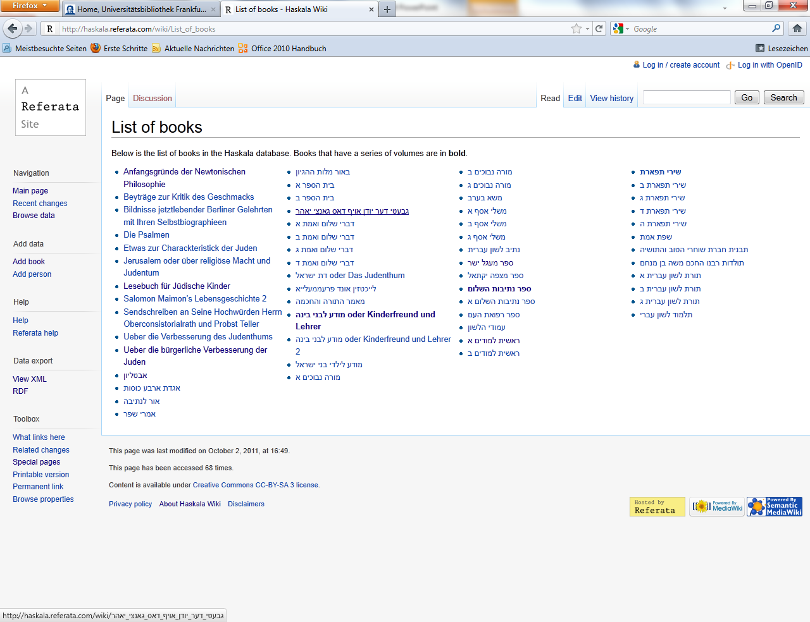

Slide 24
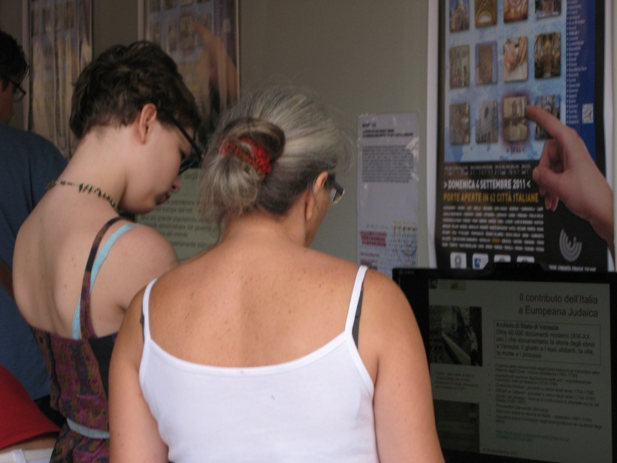
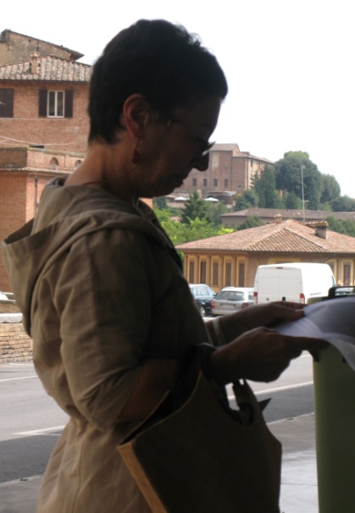
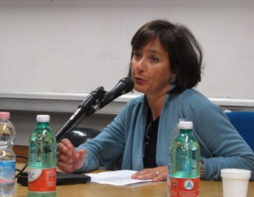
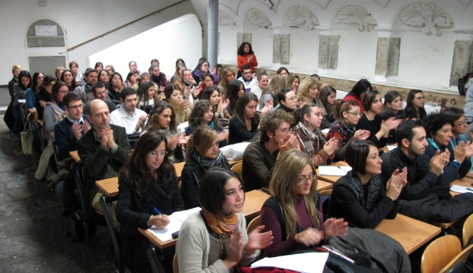
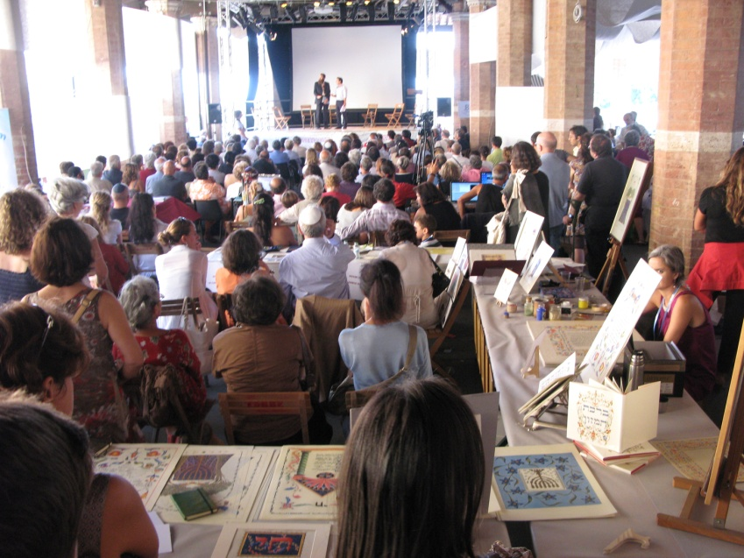
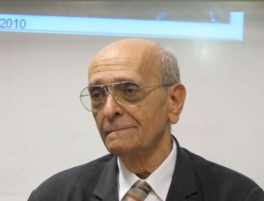
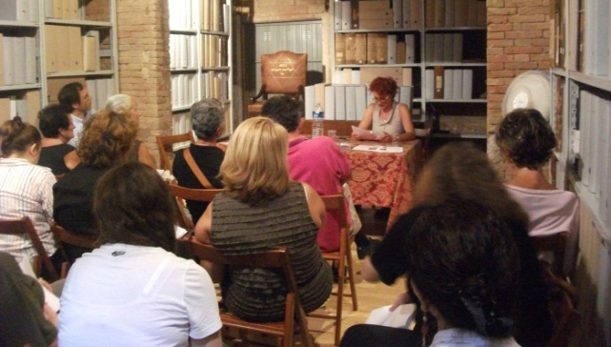
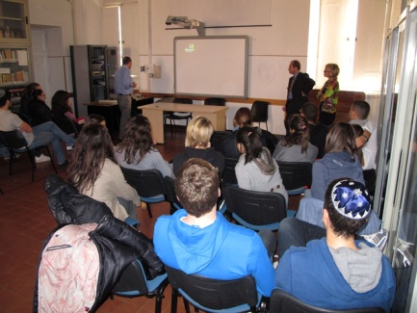
Conferences, workshops, events

Slide 25
The website judaica-europeana.eu

Slide 26
Newsletters

Slide 27
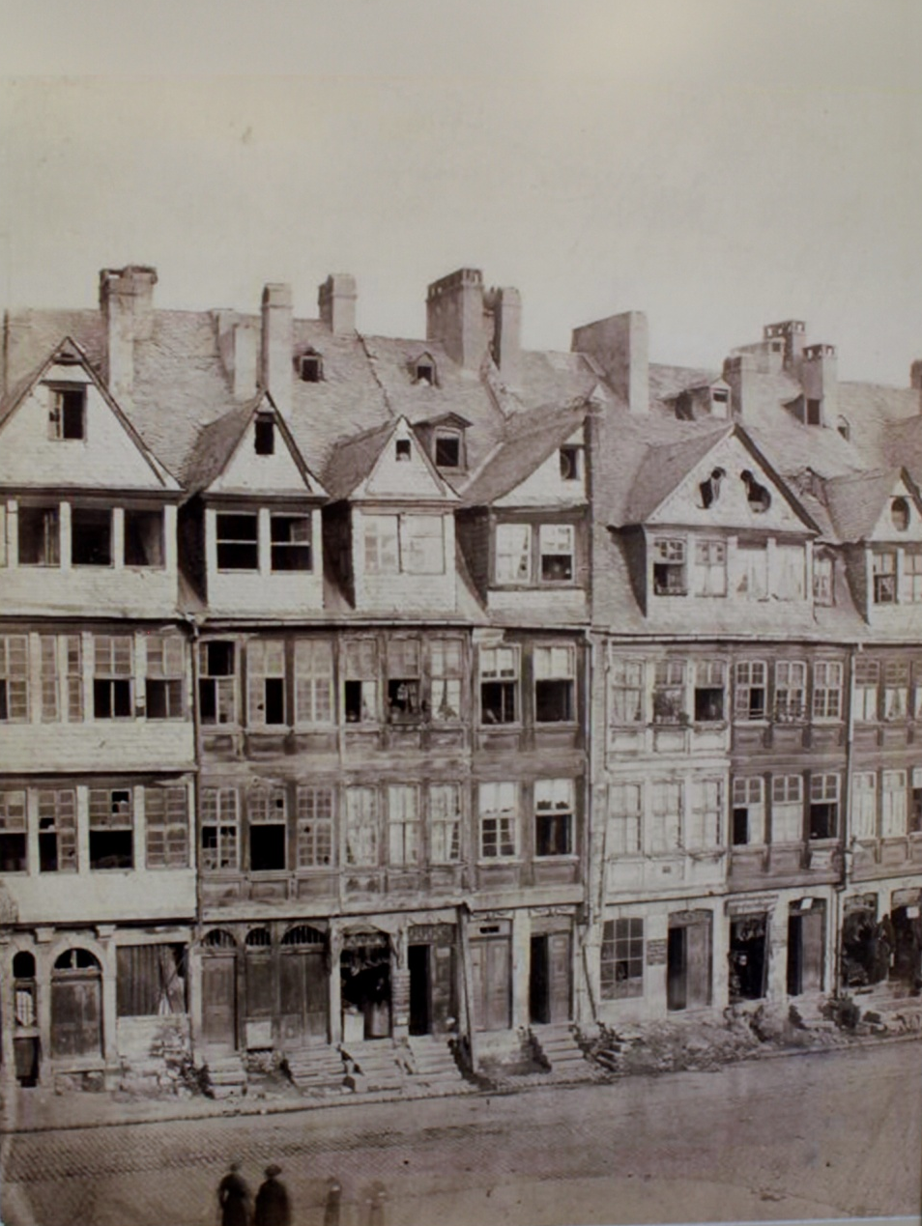
Virtual exhibitions highlighted
Judaica Europeana partners stage online exhibitions which provide a social and historical context to their collections.
They can be accessed from www.judaica-europeana.eu
Frankfurt’s Judengasse in 1870 – the remains of the old ghetto established in 1462

Slide 28
Yiddish Theatre exhibition from the Jewish Museum London

Slide 29
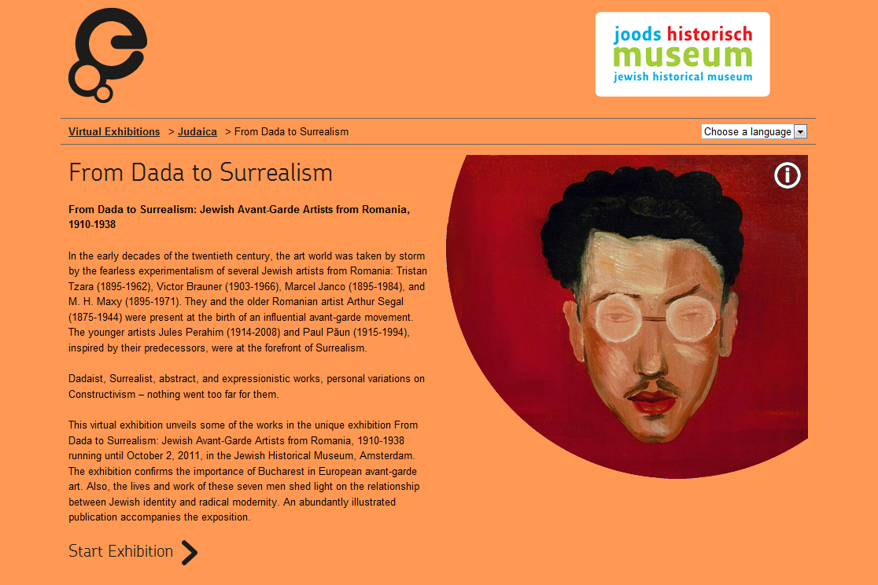
From Dada to Surrealism: Jewish avant-garde artists from Romania 1910-1938, Jewish Historical Museum, Amsterdam

Slide 30
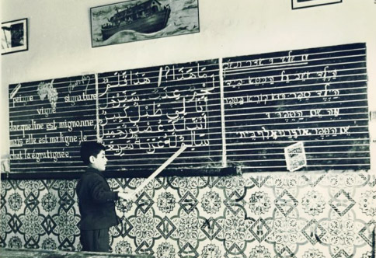
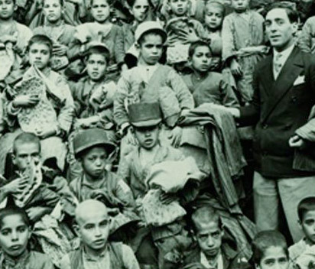
150 Years of Achievement in Education
This virtual exhibition celebrates 150 years since the establishment of the Alliance Israélite Universelle, an educational institution which created a network of schools in Morocco, Tunisia, Turkey, Ottoman Palestine, Egypt, Iraq, Syria and other countries.
Today, the AlU does its work mainly in France, the United States, Morocco and Israel.
Maghreb 1950
Iran 1929, clothes and bread are distributed to the students

Slide 31
Alliance Israélite Universelle
Sfax, Tunisia

Slide 32
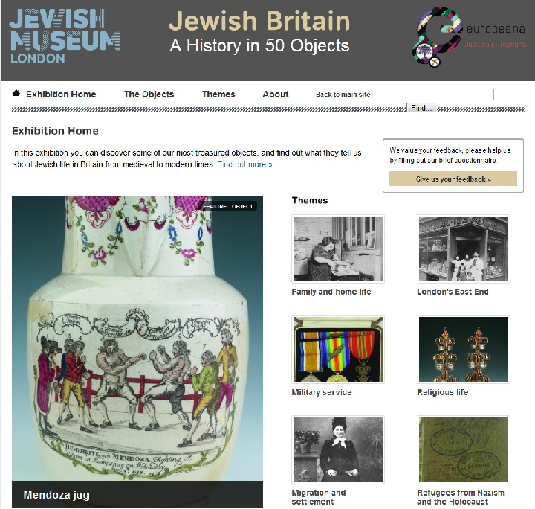
Jewish Britain: A History in 50 Objects
A virtual exhibition Jewish Britain: A History in 50 Objects showcases objects from the collections of the Jewish Museum in London. Each object tells a story about the history of the Jewish community in Britain from medieval to modern times.
The objects are grouped using different themes including: London's East End, Migration and settlement, Working lives and trades, Charity and welfare, Refugees from Nazism and the Holocaust, Growing up, Family and home life etc.

Slide 33
Jewish Museum London
Medieval mikveh (Jewish ritual bath) dating from the 13th century, discovered on a building site in Milk Street, London in 2001
Steam baths were used by the immigrant Jewish community living in London’s East End from the 19th century. They were an important part of social and religious life and were mostly used by men following work on a Friday evening, before going to the synagogue for prayers.

Slide 34
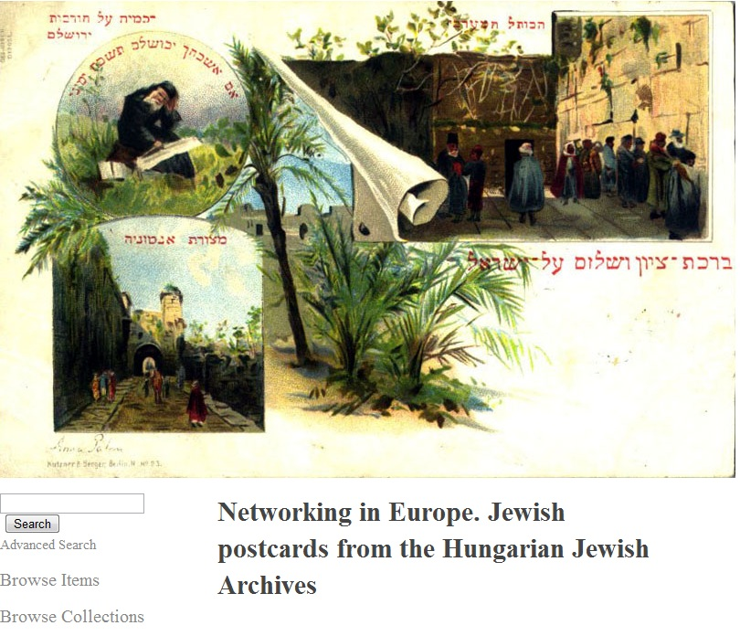
Jewish postcards from the Hungarian Jewish Archives, Budapest
This exhibition presents a selection of the Hungarian Jewish Archive historic collection of postcards from East-Central Europe and the main destinations of Jewish migration. The postcards were the first popular media representations of Jews and Jewish life.

Slide 35
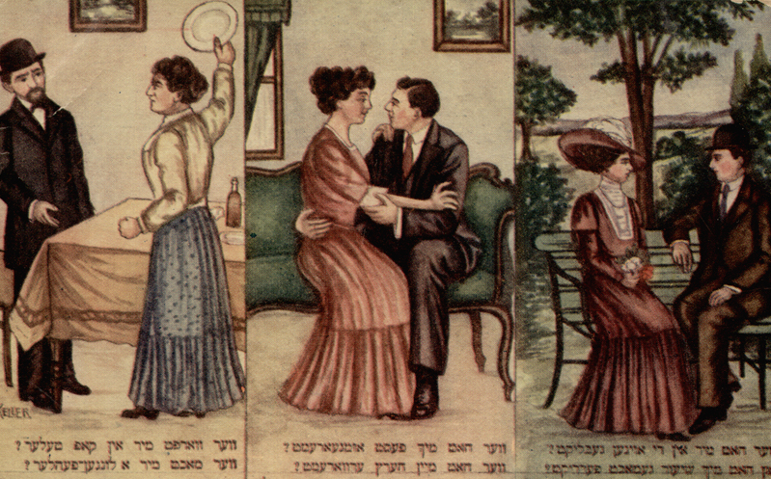
Jewish postcard exhibition from HJA
Three ages of marriage (to be read from right to left), 1920s

Slide 36
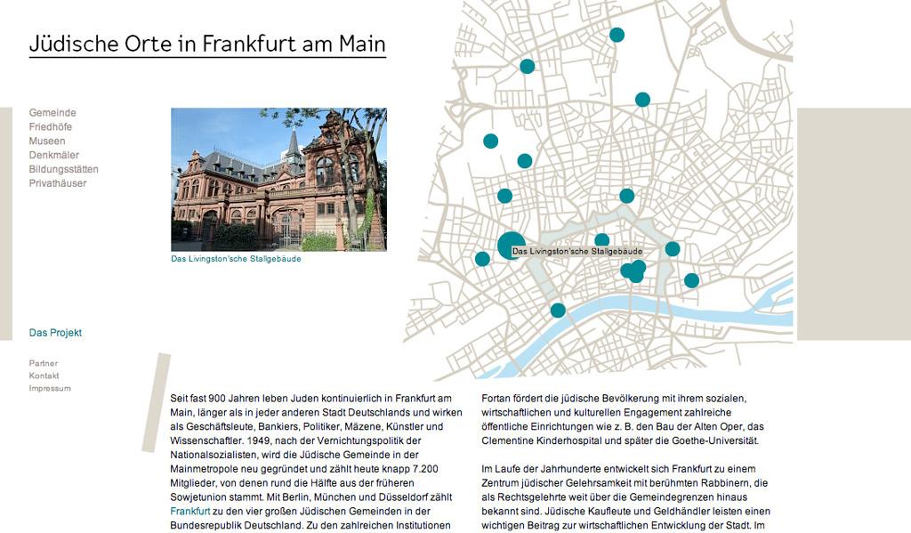
Virtual tour of Jewish Frankfurt
This exhibition from the Jewish Museum in Frankfurt provides a tour of Jewish Frankfurt: memorial sites, museums, private houses, public buildings, synagogues and cemeteries.

Slide 37
Jewish Frankfurt am Main
The Porcelain Bear building, with 1903 Art Nouveau façade was originally built to sell kitchenware, glass and porcelain.

Slide 38
Jewish Neighbourhoods of Greece
This photographic exhibition from the Jewish Museum of Greece in Athens depicts mostly pre-war Jewish life in 12 communities around Greece: Athens, Saloniki, Volos, Larissa, Ioannina, Trikala, Verola, Chalikida, Corfu, Rhodes, Xanthi and Zakynthos.
Exterior view of the synagogue, Rhodes

Slide 39
Jewish neighbourhoods of Greece, JMG, Athens
Synagogue of Corfu
Jewish women gathered for afternoon coffee, Rhodes, 1940

Slide 40
Jewish Neighbourhoods of Greece
Typical Greek Jewish trader of the twentieth century
Moses Forti, Chalkida, 1957

Slide 41
Highlights of Judaica Europeana digital collections
We invite you to explore the digital collections of Judaica Europeana partners

Slide 42
The Sephardi Museum in Toledo
The museum holds archaeological and ethnographic collections on the history of Sephardi Jews from all over the world with a special focus on the medieval period - the Golden Age of Jewish history in Spain.
It also has an important collection of Hebrew books, documents and manuscripts.

Slide 43
Sephardi Museum, Toledo
Seder haggadah shel pesaj: Im pitron belashon sefardi, Livorno, Shelomo Belforte, 1852

Slide 44
Sephardi Museum, Toledo
Festival of Purim, engraving by L.F. Dubourg, Amsterdam,1701

Slide 45
Jewish Museum of Greece in Athens
The museum’s collections reflect the history and traditions of Romaniote and Sephardi Jews of Greece: ritual and domestic objects, photographs, coins, etchings, manuscripts, documents, Holocaust testimonies, architectural heritage.
Tik, wooden case for the Sefer Torah, 19th century

Slide 46
Jewish Museum of Greece
Traditional women’s costumes from Saloniki from the 19th century
Souvenir from Saloniki postcard dated 1917

Slide 47
Jewish Museum of Greece
Haim Nahmia owner of tavern in Ioannina, with a member of the town’s military band, 1938
Jewish boy scouts from Patras on the Acropolis, Athens, 1938

Slide 48
Jewish Historical Institute, Warsaw
The JHI (ZIH) digitized the Wroclaw Jewish Community’s archives, which span the years 1744-1944. They include documents on communal life and membership, schools, hospital, various charities, electoral and death registers, burial society, emigration, the Jewish Theological Seminary Library and the Association of German Jews.
Jewish Theological Seminary, Wroclaw

Slide 49
Jewish Historical Institute, Warsaw
C
Charitable support for impoverished Jewish brides, Wroclaw, 1843
Eye Hospital and Foundation, Wroclaw 1901
1857 certificate

Slide 50
Jewish Historical Institute, Warsaw
Breslauer Jewish Community News, May 1930, commemorating the 70th birthday of Paula Ollendorf, a Jewish feminist
Lina Morgenstern, 1830-1909, philanthropist and social activist

Slide 51
Hungarian Jewish Archives, Budapest
The digitized collection includes:
Records of the Pest Jewish Community 1800-1950
Records of the Central Board of Hungarian Jewry 1868-1950
Community registers, minute books, correspondence, manuscripts
Register of pews of the Dohanyi Street synagogue
Postcard collection and photographs
Synagogue, Debreczen, c.1920

Slide 52
The Hungarian Jewish Archives, Budapest
Title page of the Sefer Zichronot
(Minute book), Community of Pest,
1850
Register of names from the minute book, Chevra Kadisha of Pest, 1827
Invitation sent by the Community of Pest to Schwab Löw, Rabbi of Prosnitz, 1835

Slide 53
Venice State Archives
Files and registers
Jewish charity 1581-1799
Regulations for Jews 1516-1799
Documents on Jews 1750-1796
Documents on Jews 1705-1795
Ghetto 1587-1647
Ghetto 1661-1740
Death records
Policies towards Jews
Arzere alchemica 2010 (Venice) by Tobia Ravà

Slide 54
Venice State Archives
Maps of the Ghetto from the Tax Office

Slide 55
Venice State Archives
Section of the ‘Scuola di San Rocco’ building in Ghetto Nuovo, from the archive “Ufficiali al cattaveri” (Tax Office)

Slide 56
Palatina Library, Parma
The De Rossi Collection of Hebrew manuscripts and incunabula from the 11th - 16th centuries
“
Yishaq ben Shelomoh ibn Sahulah The Fable of the Ancients printed in Fano by Gershom ben Mosheh Soncino, ca. 1497
Ya'Aqob ben Asher, Arba'ah turim, printed in Piove di Sacco by Meshullam Kuzi, 1475

Slide 57
Alliance Israélite Universelle, Paris
The AIU archives and library collections include:
Historic documents; photographs about AIU schools in France, other European countries and around the Mediterranean
French Jewish press and periodicals
Books and iconography copied from books
Videos about the work of AIU
Ode to peace by Aaron Cahen, sung in the Great Synagogue of Metz in1807 on Napoleon Bonaparte’s birthday.

Slide 58
Alliance Israélite Universelle
Montrouge cemetery, A. Durlacher, Paris 1886
A guide to Jewish monuments in France, Paris 1930

Slide 59
Alliance Israélite Universelle
Madame Lucie Dreyfus leaving the Rennes prison
Facsimile of a letter from Alfred Dreyfus

Slide 60
Medem Library – Paris Yiddish Centre
The Centre has the largest multimedia resource on Yiddish culture in Europe. The digital collection includes books in Yiddish and other languages, extensive collection of Yiddish press and over 4,000 recordings of Yiddish songs, klezmer and liturgical music.
Reyzele, a song by songwriter and poet Mordechai Gebirtyg (1877-1942) about a young man's love for his Reyzele.
Click on this disc to link to the recording.

Slide 61
Paris Yiddish Center—Medem Library
Moadim: Frontispice of a prayer book with commentaries in Yiddish, Amsterdam, 1768
Tsenerene : Yiddish translation of a page from the Torah, Sulzbach, 1826

Slide 62
Paris Yiddish Center—Medem Library
Hadgadyo: engraving by El Lissitzky, Editions Kultur-lige, Kiev, 1919
The journal Di royte velt n°11, Kiev, 1926

Slide 63
Frankfurt University Library
The Judaica collection is the largest in Germany and one of the most important collections worldwide: books, pamphlets, periodicals, maps, newspapers and manuscripts.
A volume of music published in 1867 by the Munich synagogue cantor M. G. Loewenstamm for the wedding of Ludwig II of Bavaria with Sofia of Bavaria. The wedding was cancelled.
Part of a large collection of Jewish music sheets, containing liturgical music, opera and folksongs.

Slide 64
Frankfurt University Library Judaica Collection
Bertha Pappenheim, who became famous as the patient Anna O. in Sigmund Freud’s psychoanalysis.
Minhagim, Amsterdam, 1722-23 © Collection of Judaica Sammlung, Universitatsbibliothek, Goethe Universitat, Frankfurt/Main

Slide 65
Frankfurt University Library
The Frankfurt Ghetto established in 1462. The buildings in this area were demolished in the late 19th century.

Slide 66
Jewish Historical Museum, Amsterdam
Jodenbuurt in Amsterdam 1889
Religion, culture and history of the Jews in the Netherlands and its former colonies are the main focus of the museum's collection, which includes works of art, ceremonial items, everyday objects and historical objects.
Jodenbuurt, E.A. Alexander 1889, oil on canvas, the Jewish quarter in Amsterdamthe Jewish 1Jewish

Slide 67
Jewish Historical Museum, Amsterdam
Two of Charlotte Salomon’s series of 1,300 gouaches entitled Life? Or Theatre, one of the highlights of the collection.

Slide 68
Jewish Historical Museum, Amsterdam
Collection box for tuberculosis hospital ‘Zonnestraal’, to be established by the Diamond Workers’ Union, 1920-1930. Part of a growing collection of everyday objects demonstrating Jewish involvement in Dutch commerce and industry.
Liesje and Hans Bloch, ca. 1939. Andries Bloch hid his personal belongings before deportation to the Westerbork transit camp in 1943. Found during house renovations they tell the moving story of the life and work of a Jewish doctor and his family.

Slide 69
Centre français des musiques juives, Paris
Oifn Pripetshik, folkloric song, Saturn Records, 78 rpm, late 1940s Title: Oif
Voix du Ghetto, Yiddish songs from the Warsaw Ghetto, Jacques Grober, 7 Productions, 1993

Slide 70
Star of David and the Italian flag: digital collection of user-generated Jewish content

Slide 71
Books, journals and archives on Jewish life in Italy

Slide 72
Stories, poetry and unpublished memoirs

Slide 73
Stella di David e Tricolore: a community archive from Siena presented by Anna di Castro
Abramo Castelnuovo’s shop in the Piazzo del Campo, Siena, early 1900s
Synagogue c.1900

Slide 74
Stella di David e Tricolore: Siena community
1929 Pesach Seder
19 March 1945, the first Jewish wedding in liberated Siena

Slide 75
The Judaica Europeana team in Budapest, 2011
¯Listen to sound clip: Eddie Harding's ‘Nightclub Boys, Yoi yoi, Mr Cohen’, Piccadilly 1930 (UK)

