Slide 1
El ingenioso hidalgo don Quixote de la Mancha

Slide 2
One work with two parts
  In Europeana you will find each part as well as ”the whole”
Derivations
  Of the whole and the parts
  Translations, adaptations and works based on
Publications incorporating multiple expressions
  drawings, engravings, forewords etc.
Different events used to associate different actors
  Expression creation event, publication event, carrier production event
Can be extended with additional records to illustrate other aspects

Slide 3
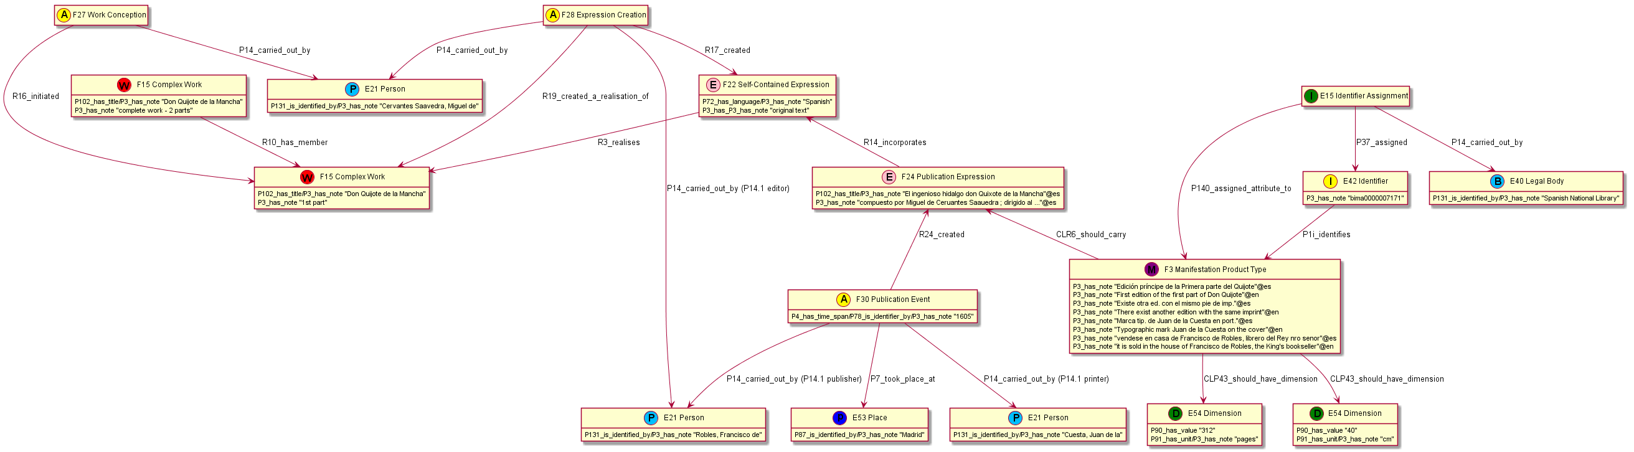
Biblioteca Nacional de España
MARC record bima0000007171

Slide 4
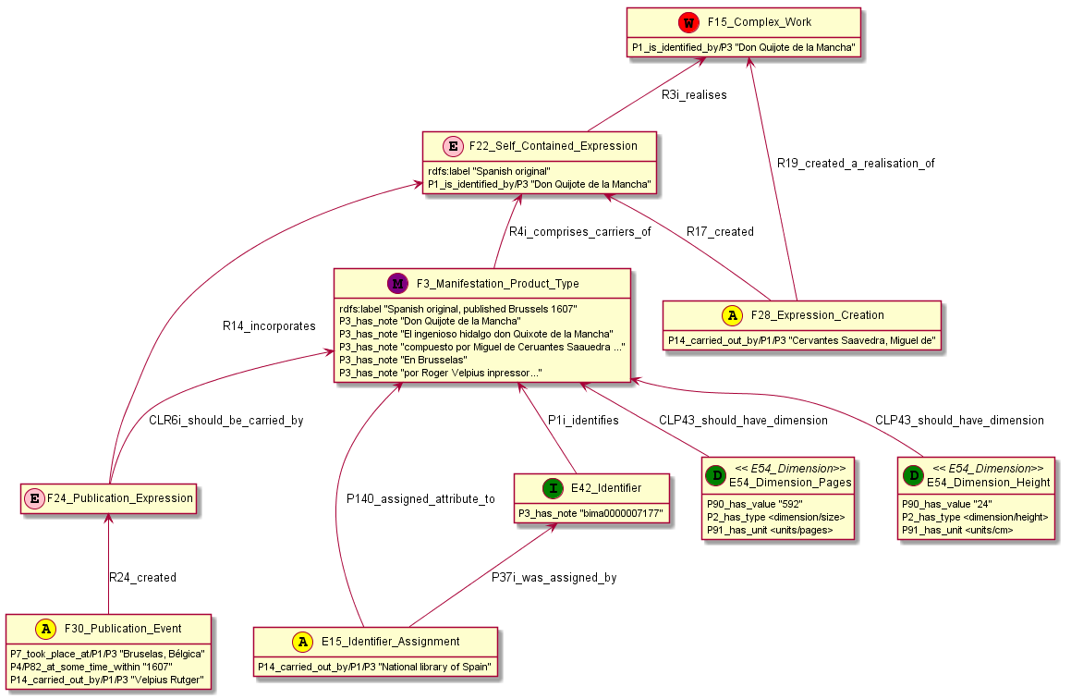
Biblioteca Nacional de España
MARC record bima0000007177

Slide 5
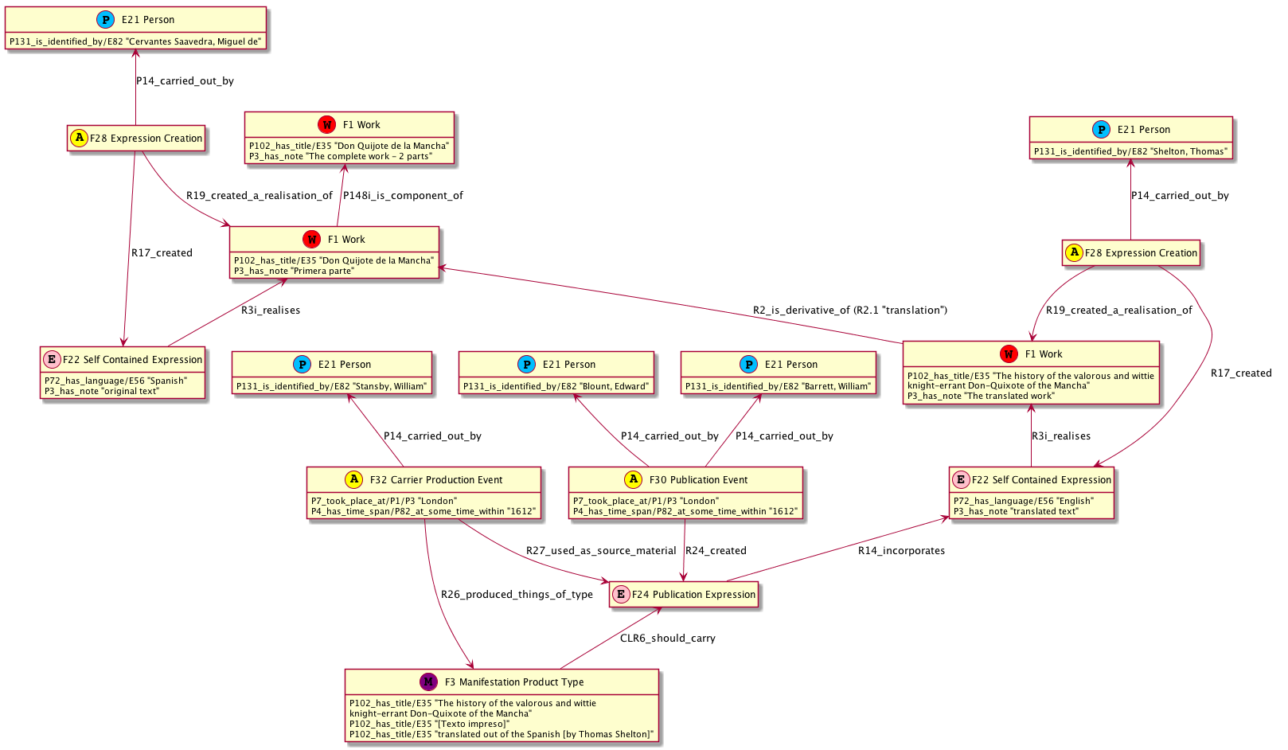
Biblioteca Nacional de España
MARC record bima0000070075

Slide 6
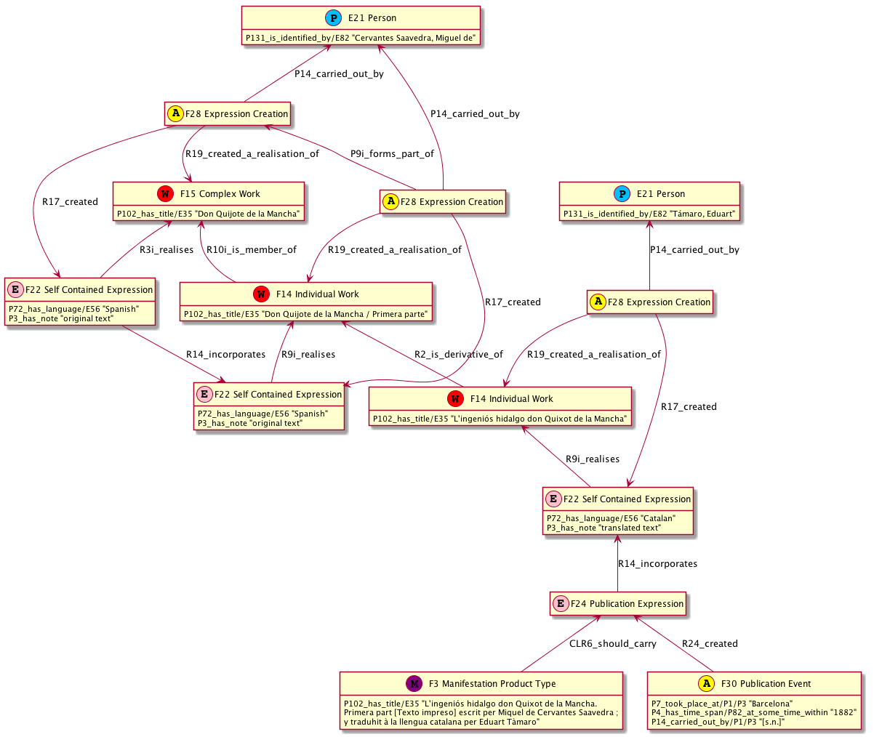
Biblioteca de Catalunya
MARC record Mimo0000660569

Slide 7
Biblioteca Nacional de España
MARC record bima0000007181

Slide 8
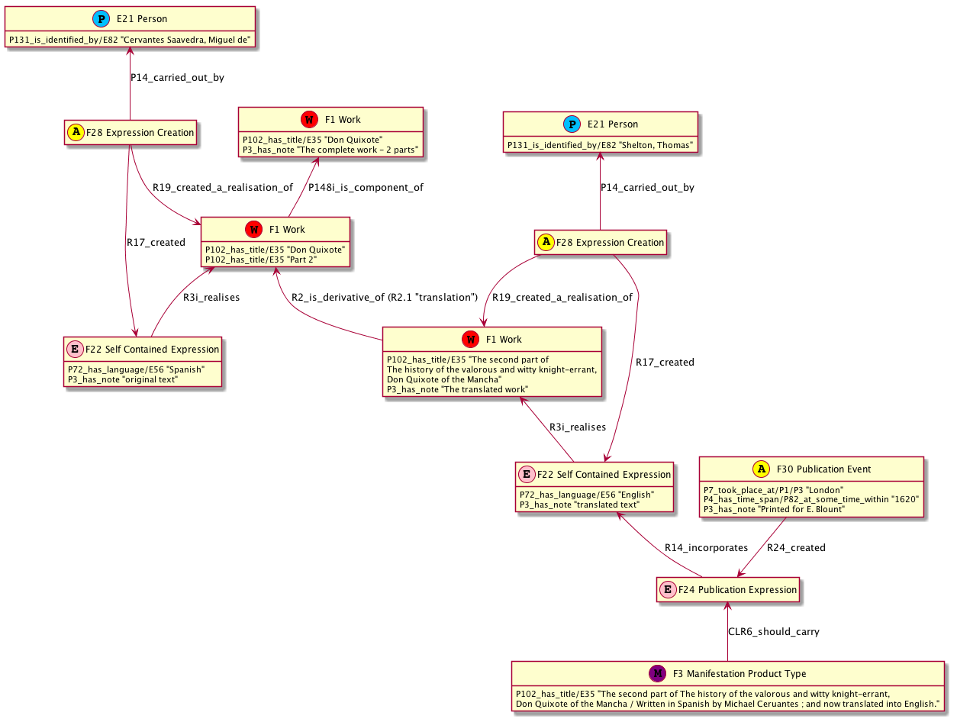
Bodleian library
MARC record 013213669

Slide 9
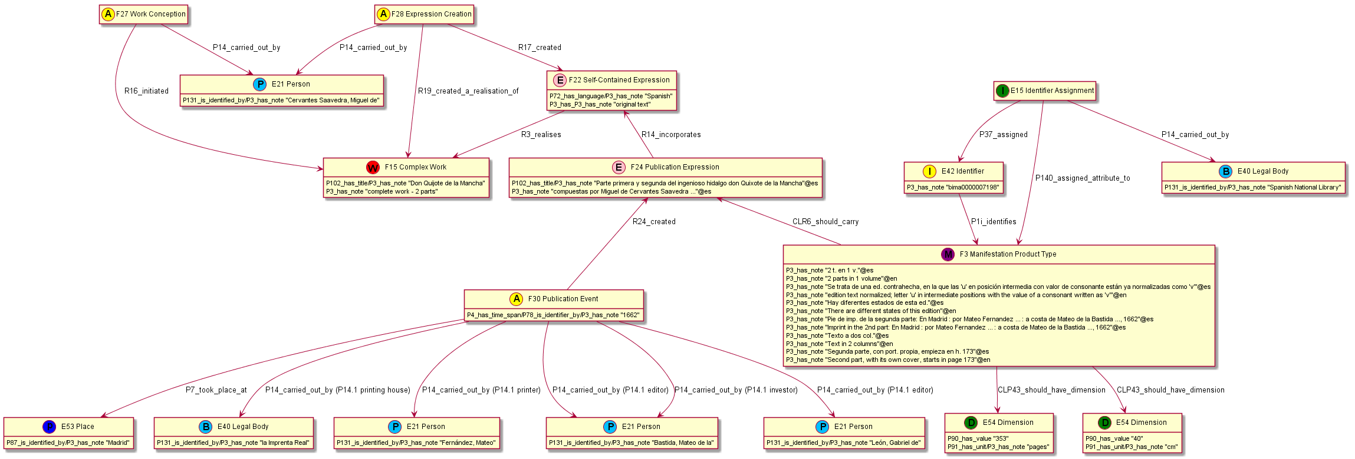
Biblioteca Nacional de España
MARC record bima0000007198

Slide 10
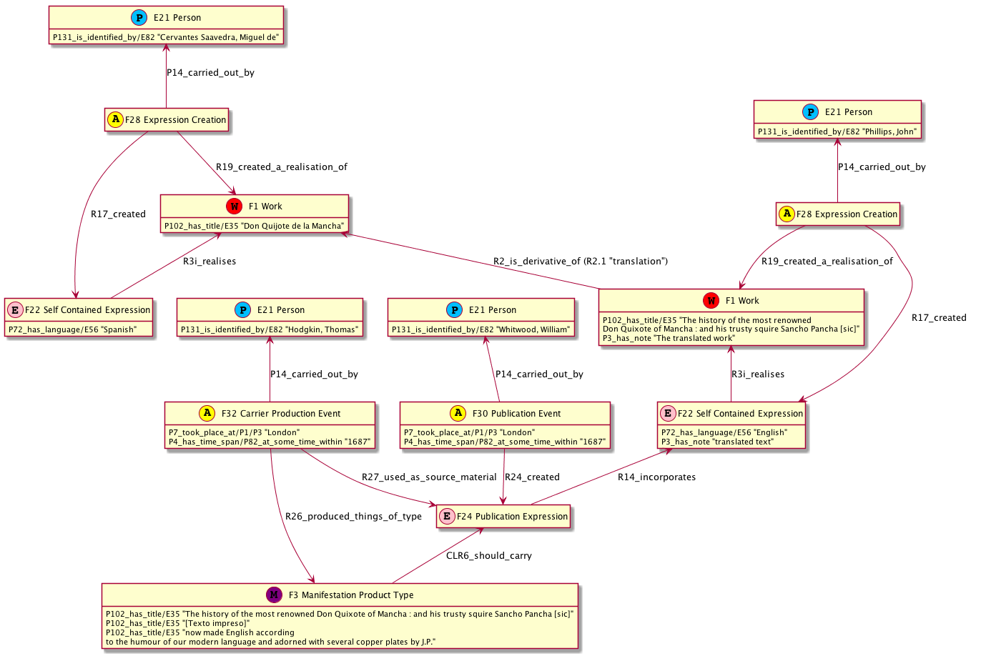
Biblioteca Nacional de España
MARC record bima0000074081

Slide 11
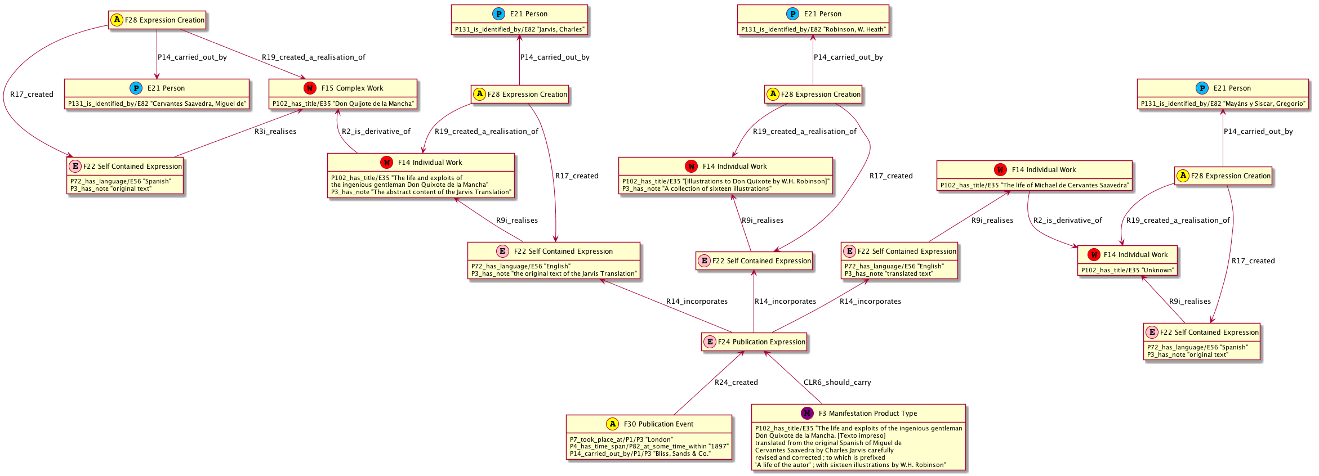
Biblioteca Nacional de España
MARC record Mimo0002044254

Slide 12
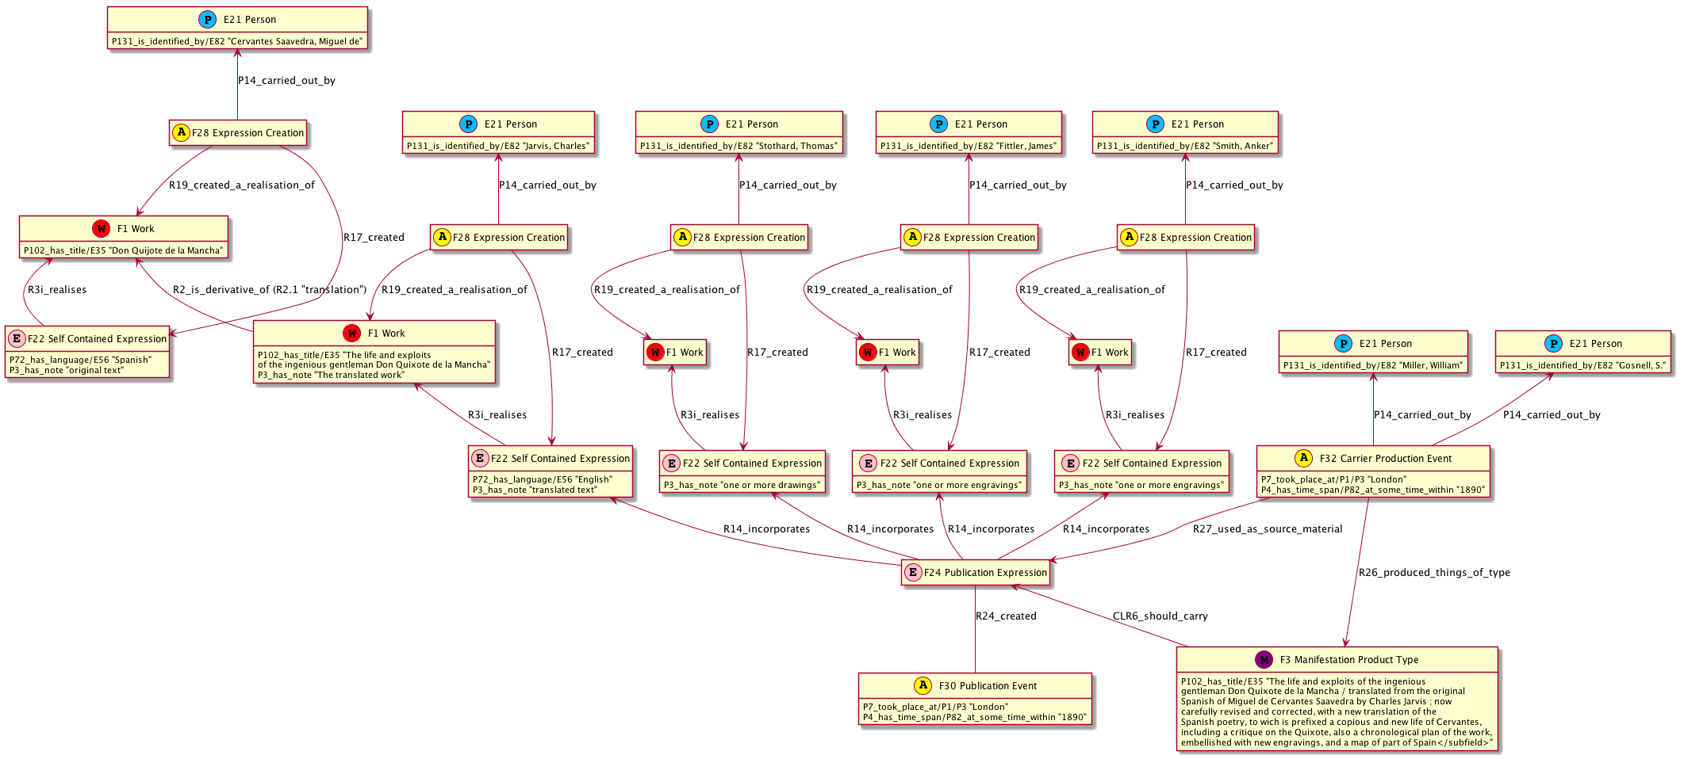
Biblioteca Digital de Madrid
MARC record BRM2009000804

Slide 13
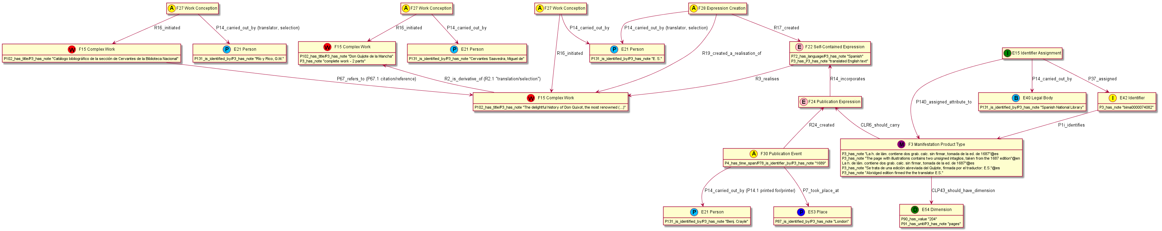
Biblioteca Nacional de España
MARC record bima0000074082

Slide 14
Bodleian library
MARC record 016754131

Slide 15
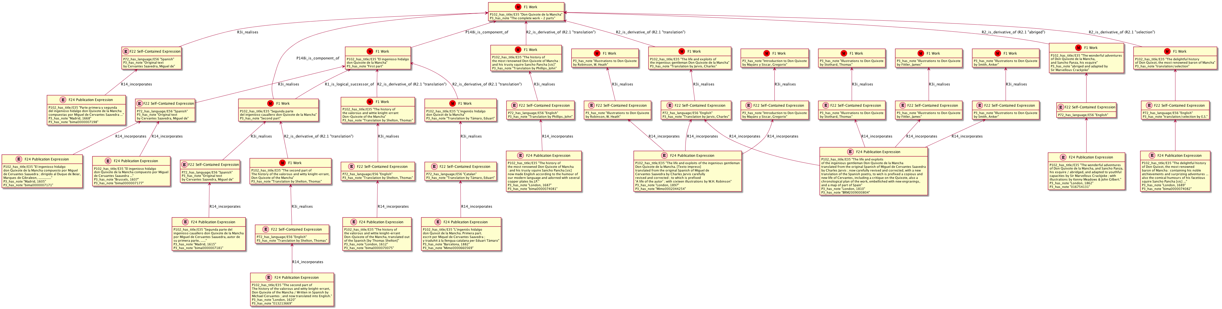
Records combined
(only works and expressions)

Slide 16
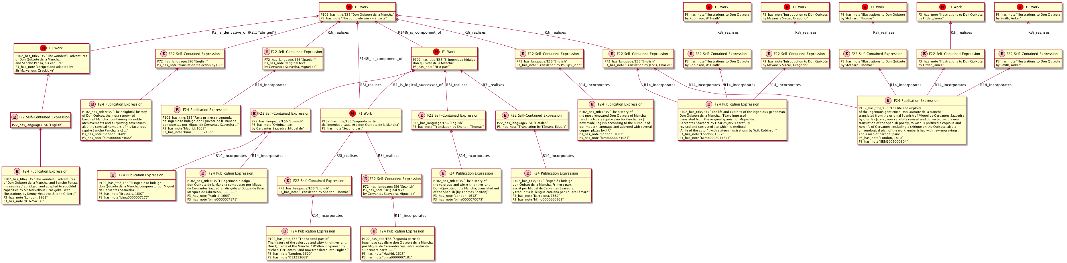
Records combined
(only works and expressions) using multiple R3 and no R2

Slide 17
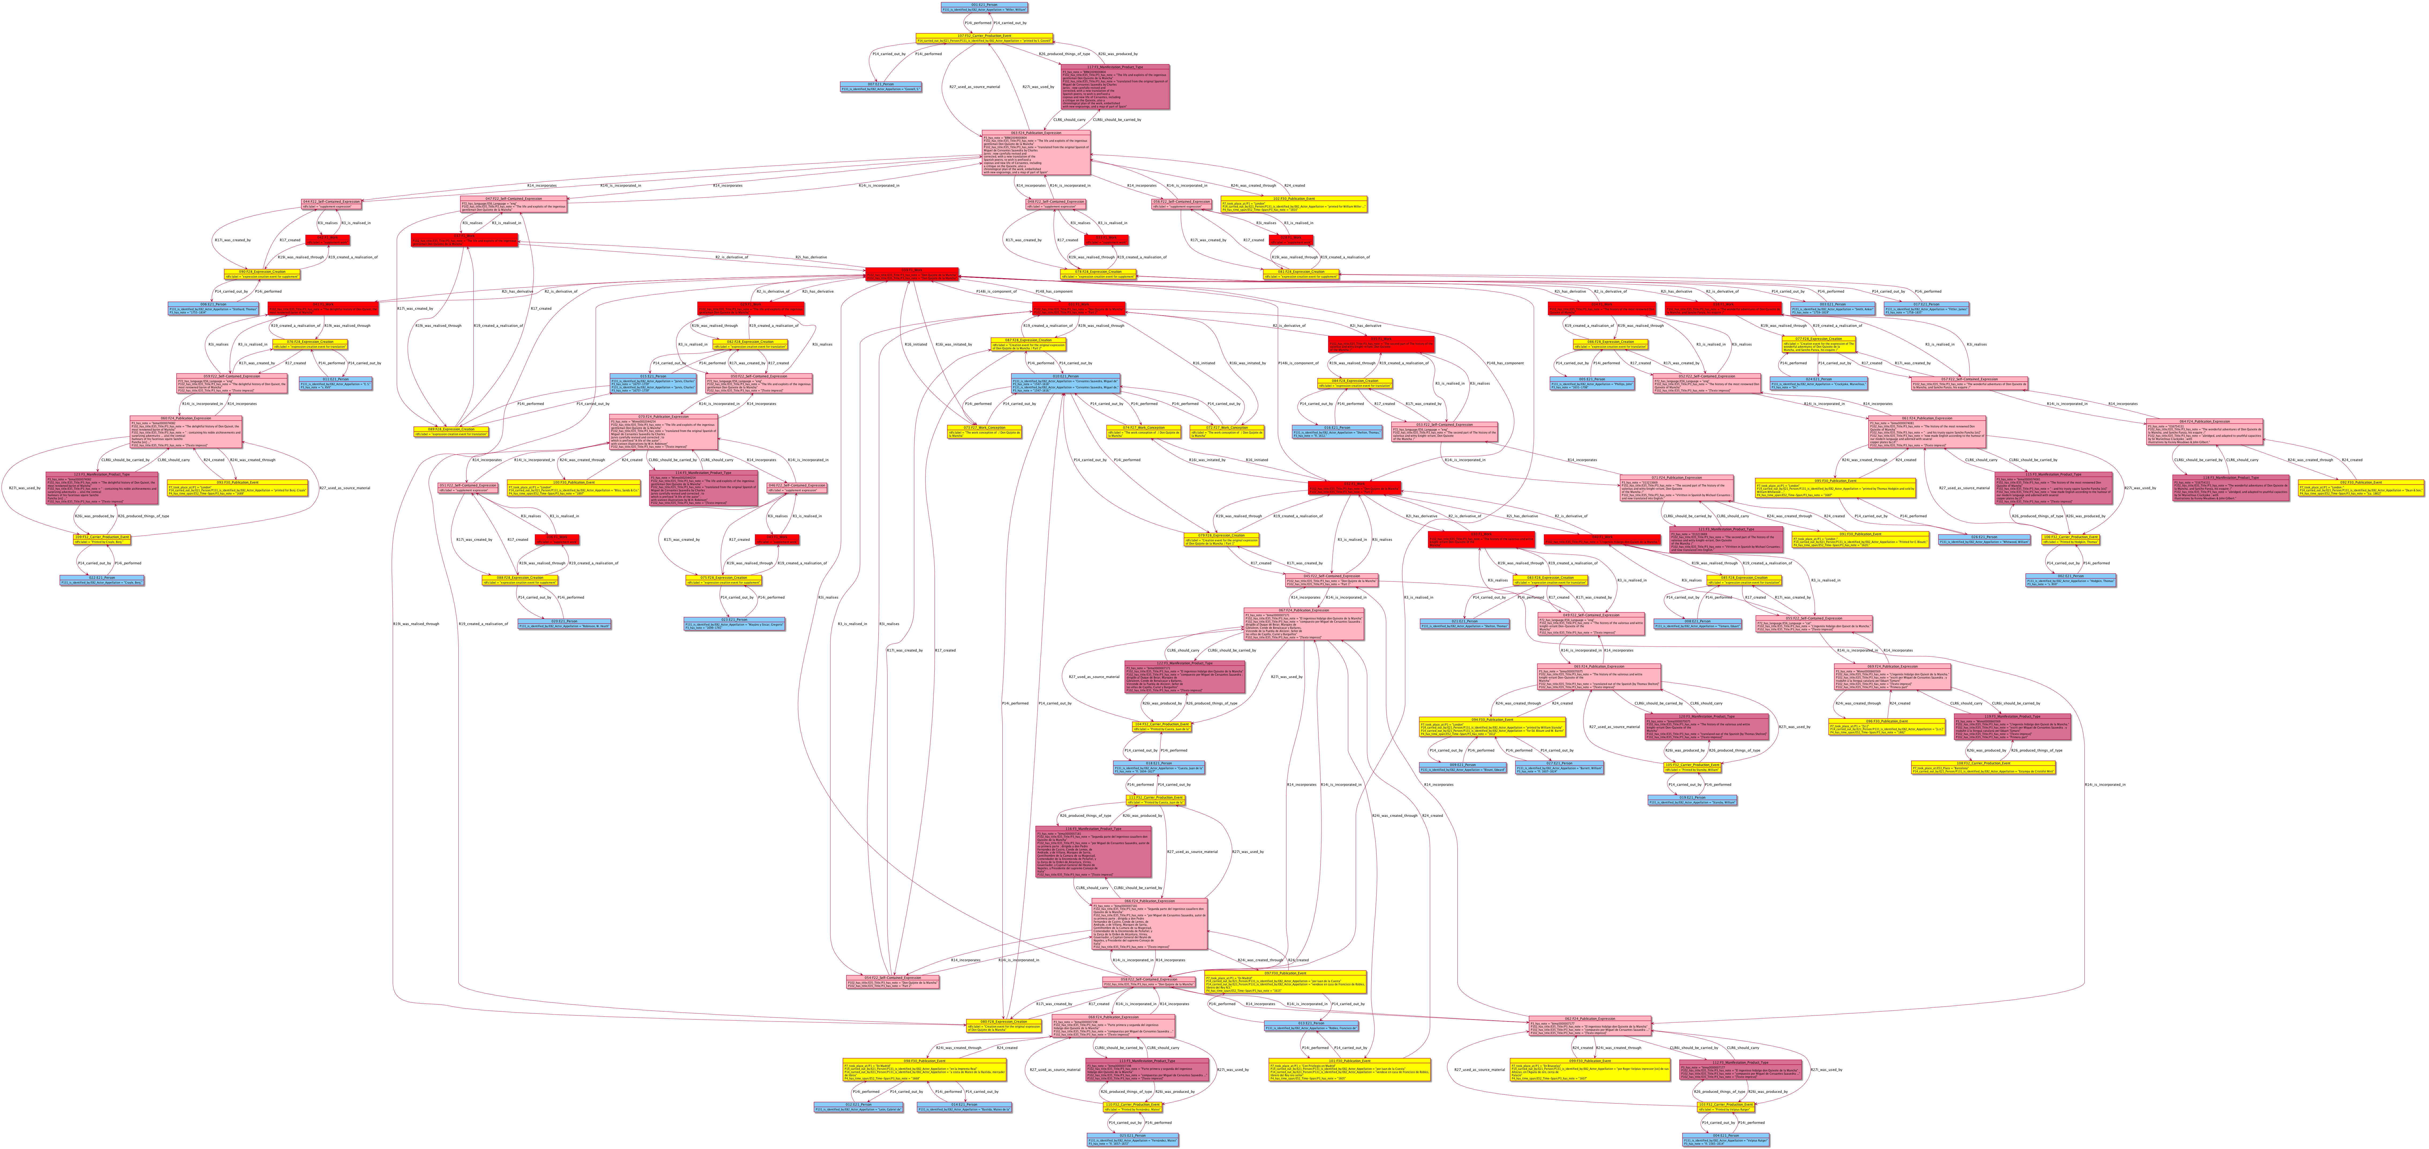
Creating graph and rdf automatically to show that frbroo-models are realistic

Slide 18
Mapping FRBRoo to EDM
(work in progress)
Rule 1
  If frbroo:F24_Publication_Expression incorporates (frbroo:R14_incorporates) exactly one F22_Self-Contained-Expression, then edm:ProvidedCHO is a sum of three FRBRoo instances:
  frbroo:F22_Self-Contained_Expression
  frbroo:F24_Publication_Expression
  frbroo:F3_Manifestation_Product_Type
Rule 2
  If frbroo:F24_Publication_Expression incorporates (frbroo:R14_incorporates) more than one F22_Self-Contained-Expression, then edm:ProvidedCHO is a sum of two frbroo instances:
  frbroo:F24_Publication_Expression
  frbroo:F3_Manifestation_Product_Type
  The frbroo:F22 instances are mapped as separate edm:ProvidedCHOs which are related to the main edm:ProvidedCHO by means of the dcterms:hasPart property.
Rule 3
  Any frbroo:F5_Items representing digital publications are mapped as edm:WebResources within the same ore:Aggregation as the entities described in rules 1 and 2.

Slide 19
TODO
Need model for last record
  And maybe one more example of derivation where the main entry creator != Cervantes (e.g. play based on Don Quixote)
We can also add more intricate examples
Need to define the mapping rules
Testing out by
  Making example models of some records
  Run an automatic transformation of FRBRoo data to EDM data

