Slide 1

EDM Workshop
EDM turns five, so now what?
2 November 2015

Slide 2
Who are we?
Any objection to taking pictures?
EDM workshop
CC BY-SA

Slide 3
Why are we here?
Celebrate EDM progress in the past 5 years
Discuss EDM short and medium-term development plans, get input on longer-term priorities (DSI year 2 and beyond)
Inventory relevant initiatives to connect with
Reflect on EDM community organization and governance
Show it’s still possible to have a say in EDM development, just as it was 5 years ago!
EDM workshop
CC BY-SA

Slide 4
Agenda (1/2)
14:00-14:20: Welcome, agenda, intros
14:20-14:35: Recap where we stand with EDM
  What we have achieved with EDM, why it is important
14:35-14:45:Current short- and medium-term plans for EDM at Europeana
14:45-15:00: Your feedback
Note taking at http://piratepad.net/EDM-workshop
EDM workshop
CC BY-SA

Slide 5
Agenda (2/2)
15:00-15:30: Your lightening talks
  Setting the scene for roundtables
15:30-15:50: Coffee break
Voting on ideas for discussion
15:50-16:20: 1st round table session
  Participants move from one table to the other
16:20-16:50: 2nd round table session
16:50-17:30: reporting from round tables, general discussion
18:00-21:00: reception, dinner, summing-up main points and next steps
Note taking at http://piratepad.net/EDM-workshop
EDM workshop
CC BY-SA

Slide 6
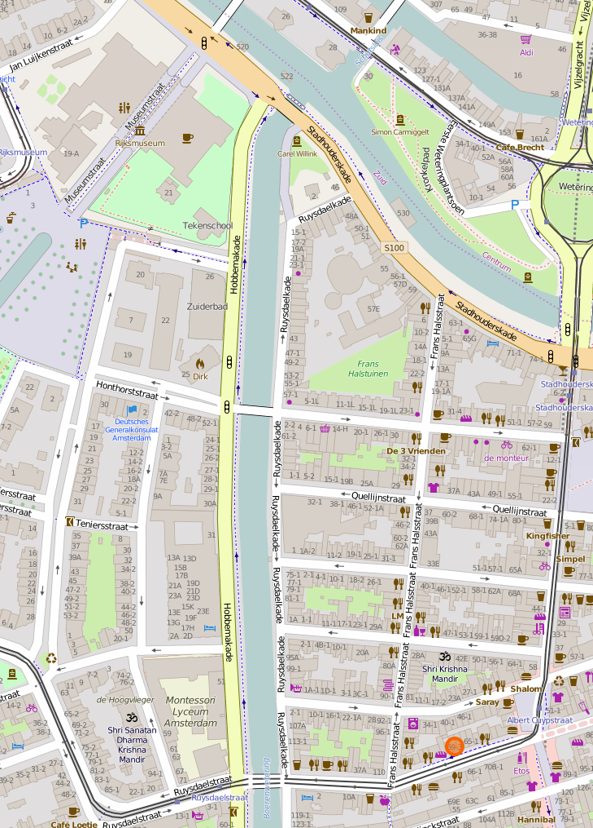
Dinner
Caffe'500
Albert Cuypstraat 59
Title here
CC BY-SA

